Slide 1

3EL82 :- BASICS OF EMBEDDED & IOT SYSTEM
18cp011- Nirdosh Gandhi
18cp012- Nikunj Rathod

Slide 2
Project:- Automatic car parking system
Definition:
In this project, we are going to display the number of slots remaining for parking in the parking lot using Arduino Board.

Slide 3
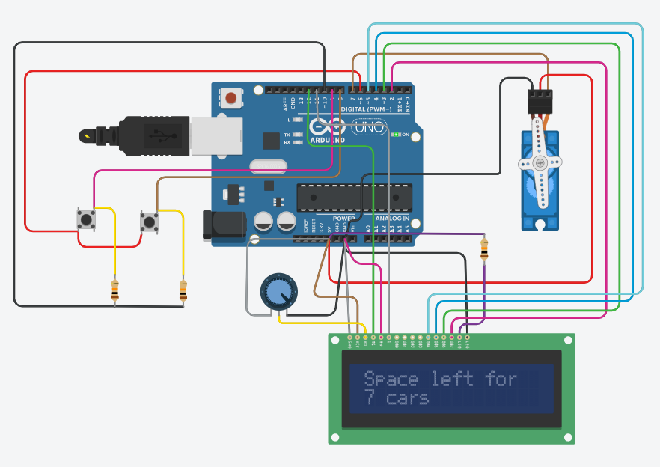
Project Glimpse

Slide 4
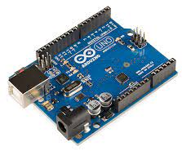
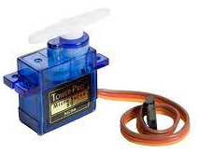
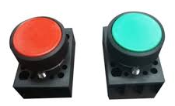
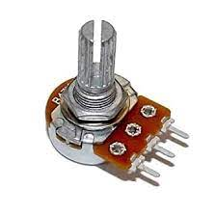
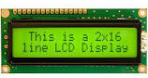
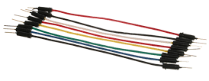
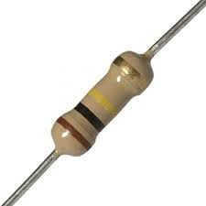
Hardware Components

Slide 5
Implementation Link
https://www.tinkercad.com/things

Slide 6
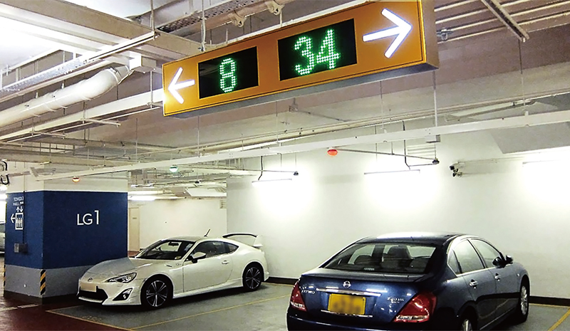
Applications
Mall Parking
Cinema Parking
Stadium Parking

Slide 7
Conclusion
In this practical we are having the empty parking slots on the screen so that we don’t need to physically go to the parking lot and check whether there is parking slot available or not. So it is very simple but effective way of using IOT in our daily life.

